Slide 1

JUnit

Slide 2
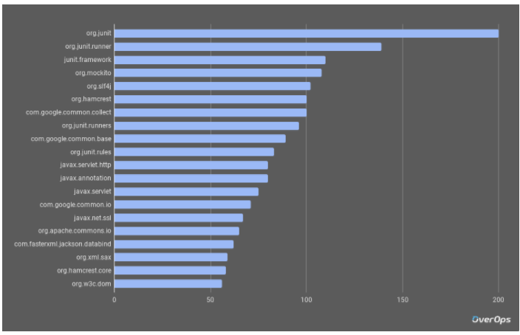
Junit
JUnit is the most important testing framework for the JVM and one of the most influential in software engineering in general.
According to several studies (2017) , JUnit 4 was the most used library for Java projects. For instance, The Top 100 Java libraries on GitHub.

Slide 3
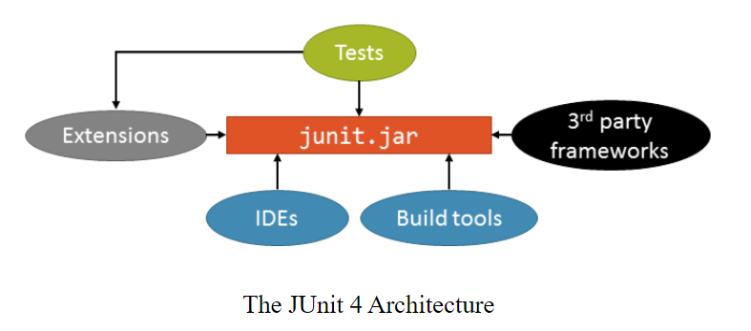
JUnit4
JUnit 4 was released back in 2006.
Not up to date with the newest testing patterns
Not up to date with newest Java language features (build in Java5)
Monolithic Architecture

Slide 4

Road to Junit5
In July 2015 Johannes Link and Marc Philipp started a crowdfunding campaign (http://junit.org/junit4/junit-lambda-campaign.html) on Indiegogo under the name JUnit Lambda
Run from July to October 2015 and raised over 54k euros from individuals and companies
4 companies donated 6 week of their own developer time

Slide 5
Junit5 Architecture
Other Tests
Third Party Libraries
Platform
IDE
Console
Build-tools
JUnit 3-4 tests
Vintage
JUnit5 tests
Jupiter

Slide 6
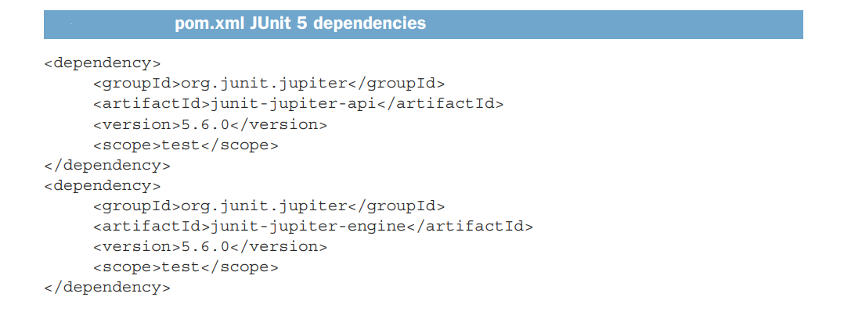
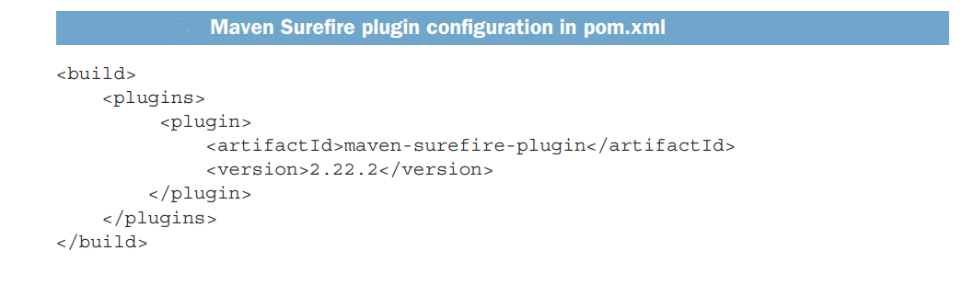
Setting up JUnit5
Jupiter API
JUnit Platform

Slide 7

JUnit Jupiter Programming Model
org.junit.jupiter.api
Annotations and meta-annotation
Custom display names
Tagging and Filtering
Nested Test classes
Dynamic tests
Core Assertions
Conditional tests execution
Parameterized Tests

Slide 8
Core Assertions
assertEquals() , assertNotNull() etc
assertThrows()
assertTimeout()
for more power AssertJ,Hamcrest etc
assertAll()
Conditional test execution
@EnabledOnOs() / @DisabledOnOs()
@EnabledOnJre() / @DisabledOnJre()
@EnabledIfSystemProperty()
@EnabledIfEnvironmentVariable()
@EnabledIf() / @DisableIf()
assumeTrue() / assumeFalse()
@Disable

Slide 9
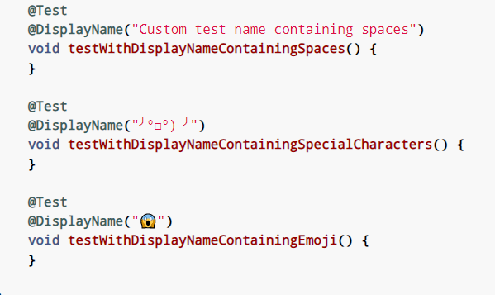

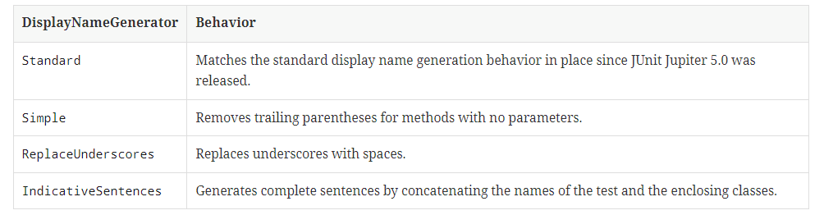
Custom display names
@DisplayName
Display Name Generators
JUnit Jupiter supports custom display name generators that can be configured via the @DisplayNameGeneration annotation.
Values provided via @DisplayName annotations always take precedence over display
names generated by a DisplayNameGenerator.

Slide 10
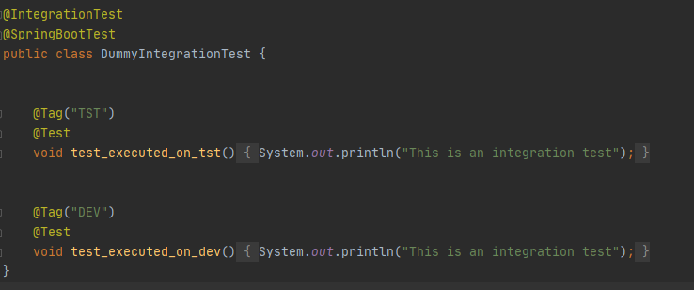
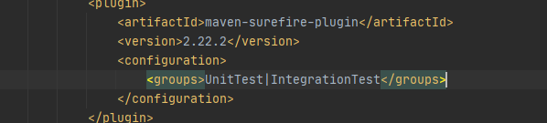
Tagging and Filtering
Tags are a JUnit Platform concept for marking and filtering tests.
Test classes and methods can be tagged via the @Tag annotation.
For filtering JUnit tests within the various phases of the Maven build, we can use the Maven Surefire plugin. The Surefire plugin allows us to include or exclude the tags in the plugin configuration:

Slide 11
Test Instance Lifecycle
@BeforeAll
By default, JUnit creates a new instance of the test class before executing each test method. This helps us to run individual test methods in isolation and avoids unexpected side effects.
Class Level Setup
@BeforeEach
Method Level Setup
Setup: This phase puts the test infrastructure in place. JUnit provides class level setup (@BeforeAll) and method level setup (@BeforeEach).
@Test
Test Execution
Test Execution: In this phase, the test execution and assertion happen. The execution result will signify a success or failure.
@AfterEach
Cleanup: This phase is used to cleanup the test infrastructure setup in the first phase. Just like setup, teardown also happen at class level (@AfterAll) and method level (@AfterEach).
Method Cleanup
@AfterAll
Class Level Cleanup

Slide 12
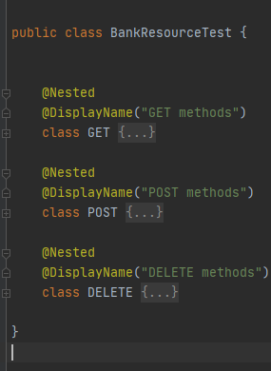
Nested Tests
@Nested tests give the test writer more capabilities to express the relationship among several groups of tests.
Such nested tests make use of Java’s nested classes and facilitate hierarchical thinking about the test structure.
Only non-static nested classes (i.e. inner classes) can serve as @Nested test classes. Nesting can be arbitrarily deep, and those inner classes are subject to full lifecycle support with one exception: @BeforeAll and @AfterAll methods do not work by default

Slide 13
Repeated Tests
@RepeatedTest(10) void repeatedTest() { System.out.println("Test is executed"); } @RepeatedTest(5) void repeatedTestWithRepetitionInfo(RepetitionInfo repetitionInfo) { System.out.println(repetitionInfo.getCurrentRepetition()); assertEquals(5, repetitionInfo.getTotalRepetitions()); }
JUnit Jupiter provides the ability to repeat a test a specified number of times by annotating a method with @RepeatedTest and specifying the total number of repetitions desired. Each invocation of a repeated test behaves like the execution of a regular @Test method with full support for the same lifecycle callbacks and extensions.
Parameterized Tests
@ParameterizedTest @ValueSource(strings = {"race", "taxi", "1234"}) void parameterized_test_1(String candidate) { assertEquals(4, candidate.toCharArray().length); }
Parameterized tests make it possible to run a test multiple times with different arguments. They are declared just like regular @Test methods but use the @ParameterizedTest annotation instead. In addition, you must declare at least one source that will provide the arguments for each invocation and then consume the arguments in the test method

Slide 14
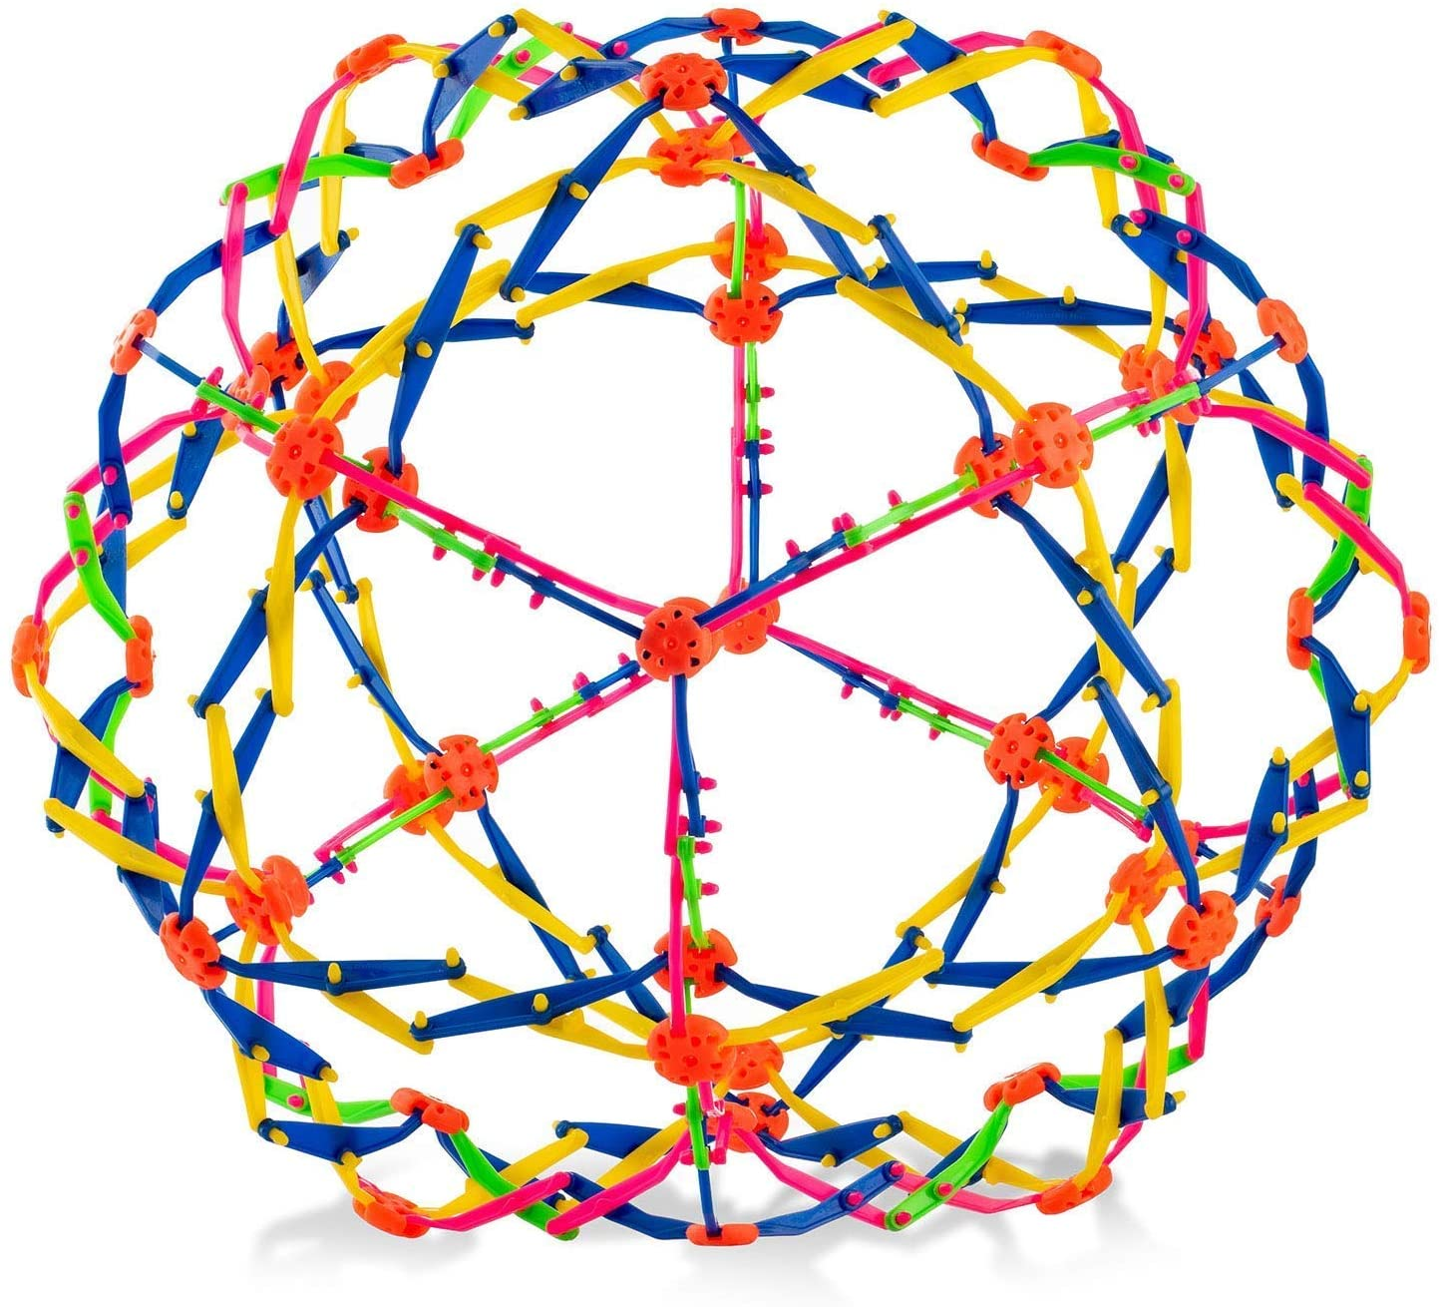
JUnit 5 Extension Model
The purpose of Junit 5 extensions is to extend the behavior of test classes or methods, and these can be reused for multiple tests.
Before Junit 5, the JUnit 4 used two types of components for extending a test: test runners and rules. By comparison, JUnit 5 simplifies the extension mechanism by introducing a single concept: the Extension API.
Declaratively - @ExtendWith
Programmatically - @RegisterExtension
Lifecycle callbacks
Parameter resolution
Exception handling
Conditional test execution
Test instance post-processing

Slide 15
Conditional Test Execution
JUnit 5 provides a type of extension that can control whether or not a test should be executed.
This is defined by implementing the ExecutionCondition interface.
public class EnvironmentExecutionCondition implements ExecutionCondition { @Override public ConditionEvaluationResult evaluateExecutionCondition(ExtensionContext context) {
return extensionContext.getTags().contains("ACC") ? enabled("Enabled") :
disabled("Disabled"); }
@Test
@ExtenhWith(EnvironmentExecutionCondition.class) @Tag("ACC") void regression_test() { System.out.println("Run regression test"); }

Slide 16
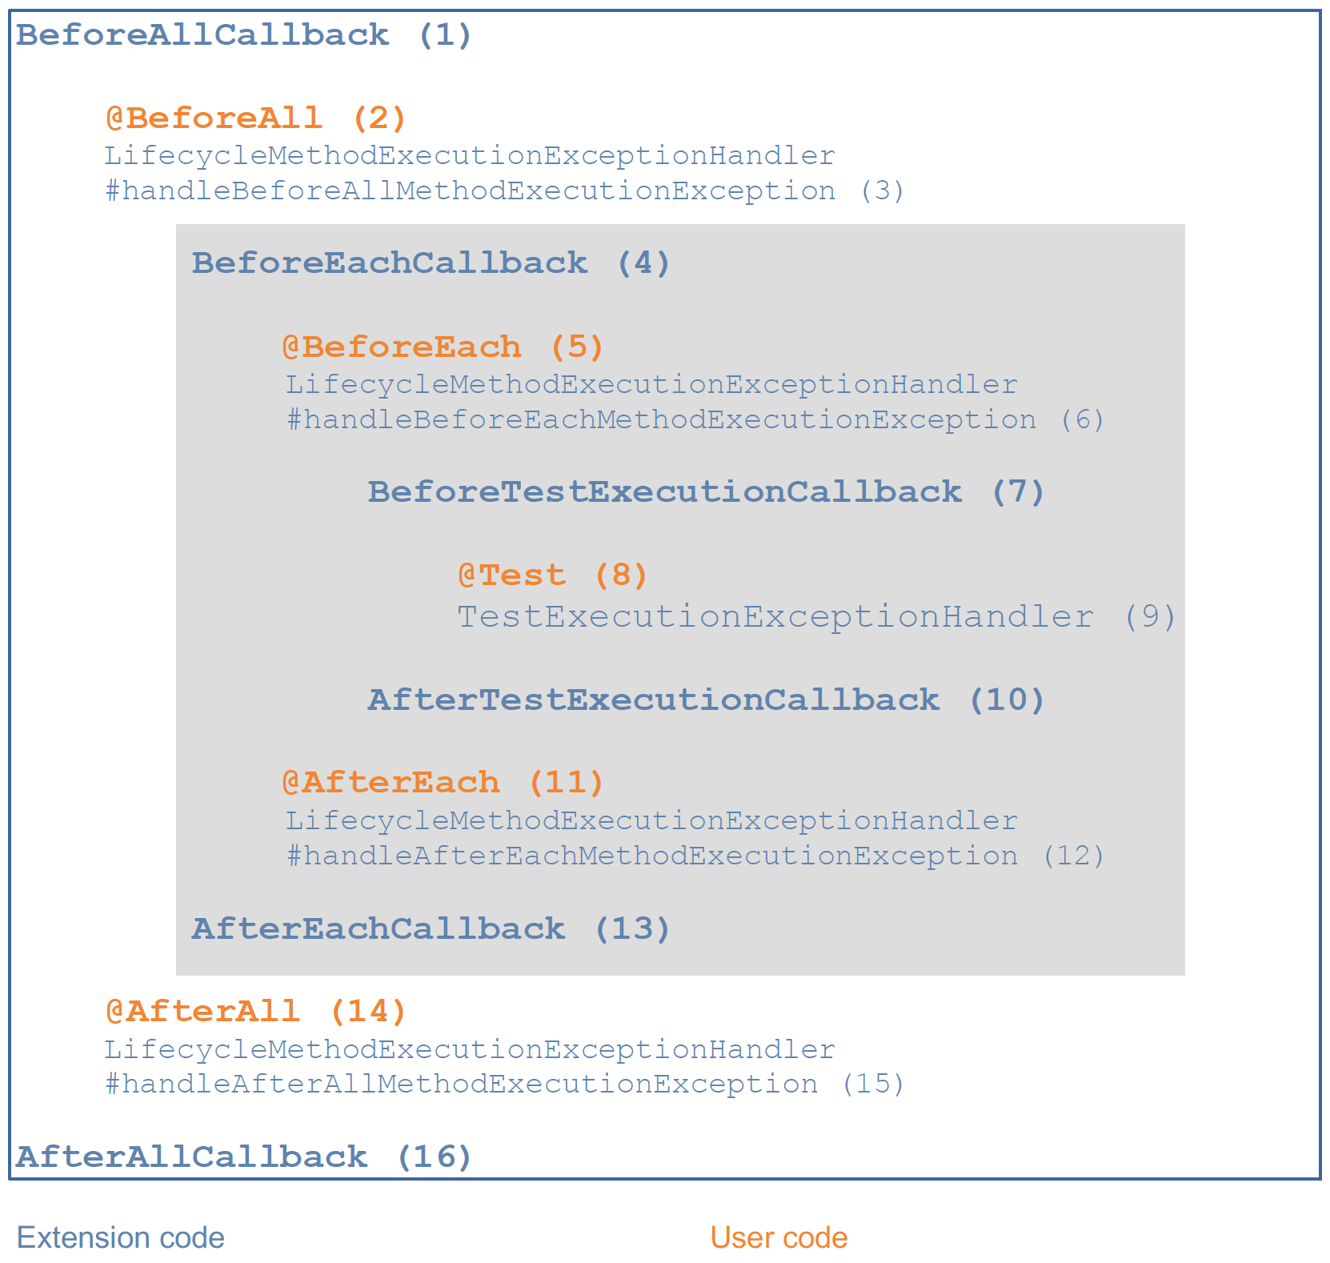
Lifecycle callbacks
The following interfaces define the APIs for extending tests at various points in the test execution lifecycle.
BeforeAllCallback and AfterAllCallback – executed before and after all the test methods are executed
BeforeEachCallBack and AfterEachCallback – executed before and after each test method
BeforeTestExecutionCallback and AfterTestExecutionCallback – executed immediately before and immediately after a test method
Each of these interfaces contains a method we need to override.

Slide 17
Parameter resolution
public class TestRestTemplateParameterResolver implements ParameterResolver { @Override public boolean supportsParameter(ParameterContext parameterContext, ExtensionContext extensionContext) throws {
// Check if the parameter provided is valid
} @Override public Object resolveParameter(ParameterContext parameterContext, ExtensionContext extensionContext) throws {
//Instantiate the parameter }
By implementing ParameterResolver you can serve up objects of any type to your test methods
ParameterResolver – has two methods:
supportsParameter() – returns true if the parameter’s type is supported (TestRestTemplate in this example)
resolveParamater() – serves up an object of the correct type (new TestRestTemplate), which will then be injected in your test method
@TestRestTemplateResolver @SpringBootTest(webEnvironment = SpringBootTest.WebEnvironment.RANDOM_PORT) public class LifecycleTest { @Test public void test_endpoint(TestRestTemplate template) throws URISyntaxException { template.exchange(request, new ParameterizedTypeReference<Object>() { }); }

Slide 18
The End

